Slide 1
Flight Ticket Price Prediction
By
VANISREE P G

Slide 2
ACKNOWLEDGMENT
First I would like to thank the Almighty for his wonderful presence with me throughout this project and helped me to make it as a successful one. For my internship I had the pleasure of working at FILP ROBO Was a great chance for acquired knowledge, personal and Professional development. I extend whole hearted thanks to FILP ROBO under whom I worked and learned a lot and for enlightening me with their knowledge and experience to grow with the corporate working
This is a great pleasure to express my deep sense of gratitude and thanks to SME for his valuable ideas, instantaneous help, effective support and continued encouragement which enabled for the successful completion of the project. These are the following website which I referred for the references.
https://scikit-learn.org/
https://kaggle.com
www.google.com
www.geeksforgeeks.org

Slide 3
Business Problem Framing
With respect to the season flight price also differs in the market, we have seen lot of changes in the Flight ticket price. Now some flight tickets are in demand hence making them costly and some are not in demand hence cheaper. With the change in market due to covid 19 impact, our customers are facing problems with their previous flight price valuation machine learning models. So, they are looking for new machine learning models from new data. We have to make flight ticket price valuation model.
Someone who purchase flight tickets frequently would be able to predict the right time to procure a ticket to obtain the best deal. Many airlines change ticket prices for their revenue management. The airline may increase the prices when the demand is to be expected to increase the capacity. To estimate the minimum airfare, data for a specific air route has been collected including the features like departure time, arrival time and airways over a specific period. Features are extracted from the collected data to apply Machine Learning (ML) models. This paper gives the machine learning regression methods to predict the prices at the given time.

Slide 4
Motivation for the Problem Undertaken
To understand real world problems where Machine Learning and Data Analysis can be applied to help to predict the prices in various domains to make better decisions with the help of which they can gain profit or can be escaped from any loss which otherwise could be possible without the study of data.
The evaluating system as a result changes the charge depending on time, season, and festive days to change the header or footer on successive pages. The ultimate aim of the airways is to earn profit whereas the customer searches for the minimum rate. Customers usually try to buy the ticket well in advance of departure date so as to avoid hike in airfare as date comes closer. But actually this is not the fact. The customer may wind up by giving more than they ought to for the same seat.

Slide 5
Data Sources
Data is Scrapped from a Yatra.com is an Indian online travel agency and travel search engine web portal for booked a flight ticket. The data is scraped from the Yatra.com website The data descriptions are as follow:- (2103, 10) rows and columns. To predict Flight prices using Regression. I will start by importing all the necessary libraries that we need for this task and import the dataset.
1) Importing libraries
2) Importing the dataset
They are totally 2103 rows and 10 columns in a csvfile. Our target is to find the insights of the data and to do thorough data analysis.

Slide 6
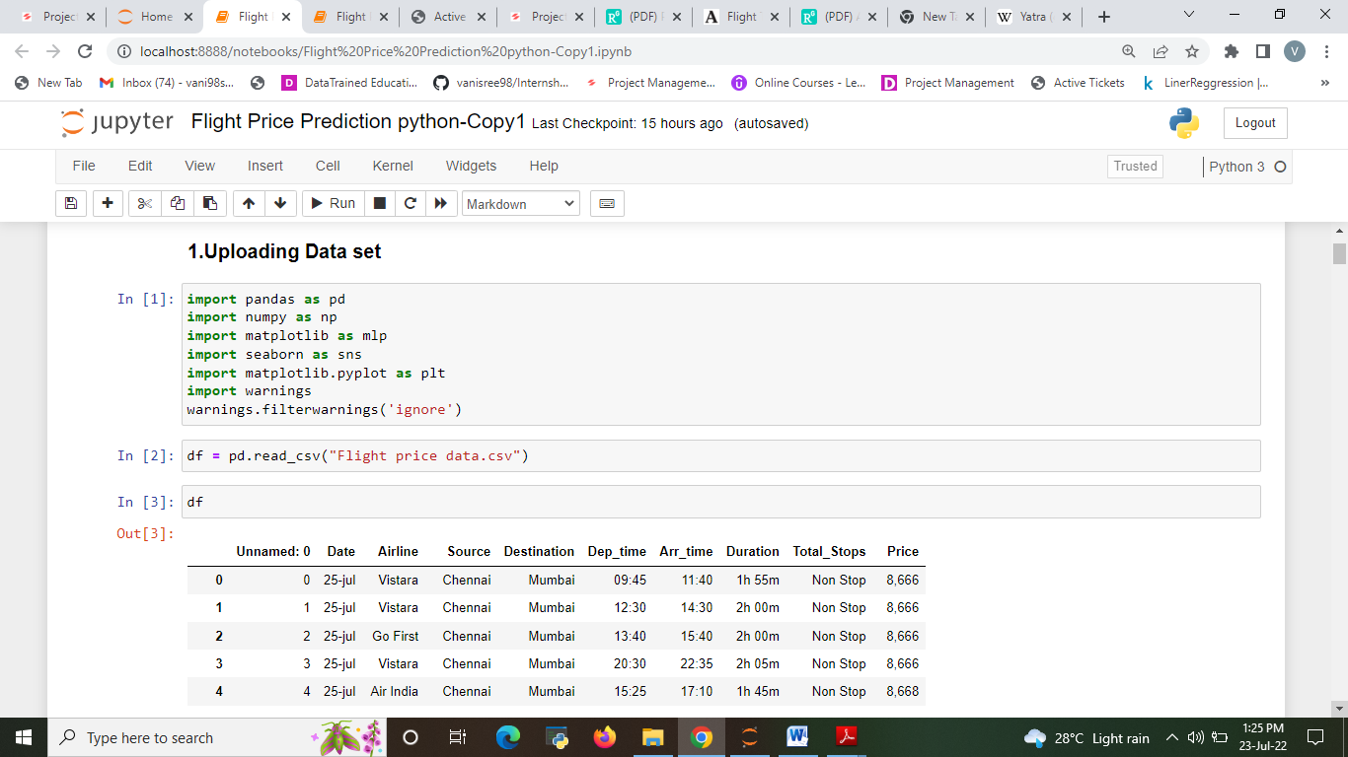
DATA UPLOADING

Slide 7
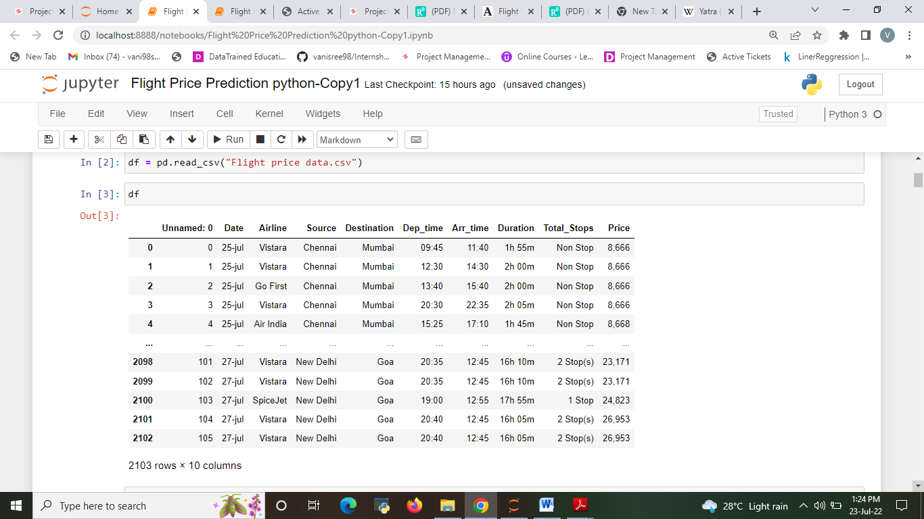

Slide 8
Data Pre-processing Done
The raw data is taken and performed various steps to reduce skewness, outlier, class imbalance and scaling. There were null value was present and removed the values from the dataset. Many outlier removal and skewness removal methods are tested and best method is chosen in order to prevent data loss.
The dataset contains 2103 rows and 10 columns
Price is our dependent variable.
We created new features from old ones.
There are no null values in the dataset.
Removed empty cells

Slide 9
HARDWARE AND SOFTWARE REQUIREMENTS AND TOOLS USED
Hardware used for doing the project is a ‘Laptop’ with high end specification and stable internet connection .while coming to the software part I had used ‘python jupyter notebook’ for do my python program and data analysis.
Excel file and Microsoft excel are required for the data handling. In jupyter notebook I had imported lot of python libraries are carried to this project and I have mentioned below detailed.
1.Pandas-a library which is used to read the data ,visualization and analysis of data.
2.Numpy-used for working with array and various mathematical operations in python.
3.Seaborn- visualization for plotting different type of plot.
4.Matplotlib- It provides an object-oriented API for embedding plots into applications
5.Selenium- to scrape the data

Slide 10
Data Inputs- Logic- Output Relationships
input data contains 2103 rows and 10 columns.
Predictor variable are,
Airline: Name of the airline used for traveling
Date_of_Journey: Date at which a person traveled
Source: Starting location of flight
Destination: Ending location of flight
Dep_Time: Departure time of flight from starting location
Arr_Time: Arrival time of flight at destination
Duration: Duration of flight in hours/minutes
Total_Stops: Number of total stops flight took before landing at the destination.
Target variable is Price of the flight ticket

Slide 11
MODELS USED
Regression Model with following algorithms
Linear Regression
Decision Tree Regression
Random forest regression
Gradient Boosting Regression
Ridge
SVR
Evaluation metrics
Mean square error
Mean absolute error
R2 score
Root Mean Squared Error

Slide 12
Testing of Identified Approaches (Algorithms)
Listing down all the algorithms used for the training and testing.
LR=LinearRegression()
DT=DecisionTreeRegressor()
GBR=GradientBoostingRegressor()
rf=RandomForestRegressor()
R=Ridge()

Slide 13
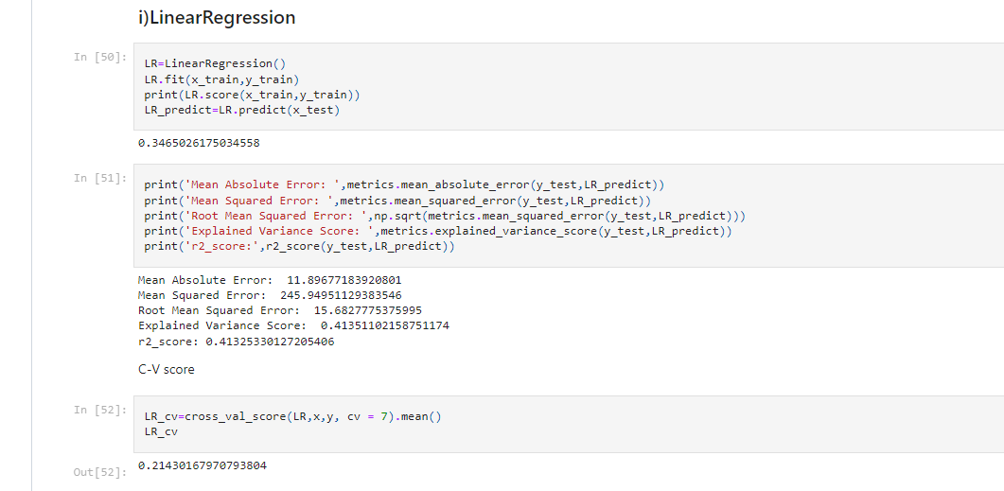
Run and Evaluate selected models 1.Linear Regression
Describe all the algorithms used along with the snapshot of their code and what were the results observed over different evaluation metrics.

Slide 14
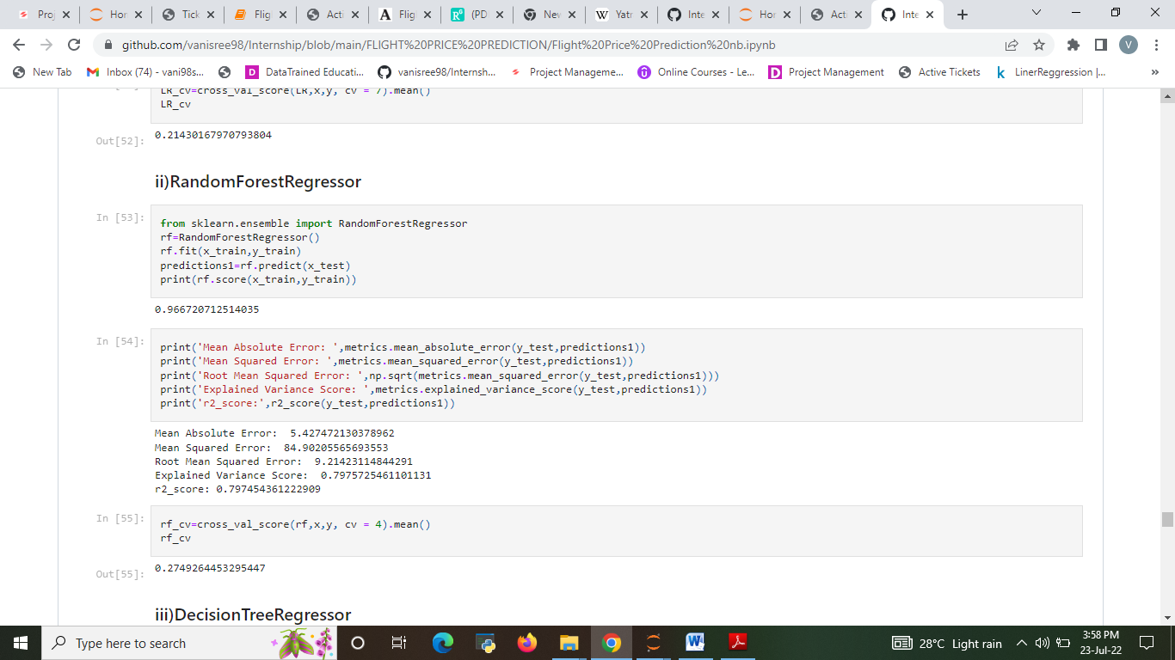
2.Random Forest Regressor

Slide 15

3. Decision Tree Regression

Slide 16
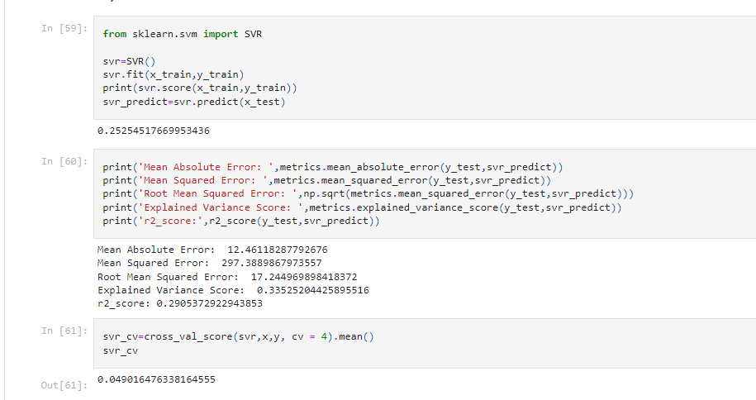
4.SVR

Slide 17
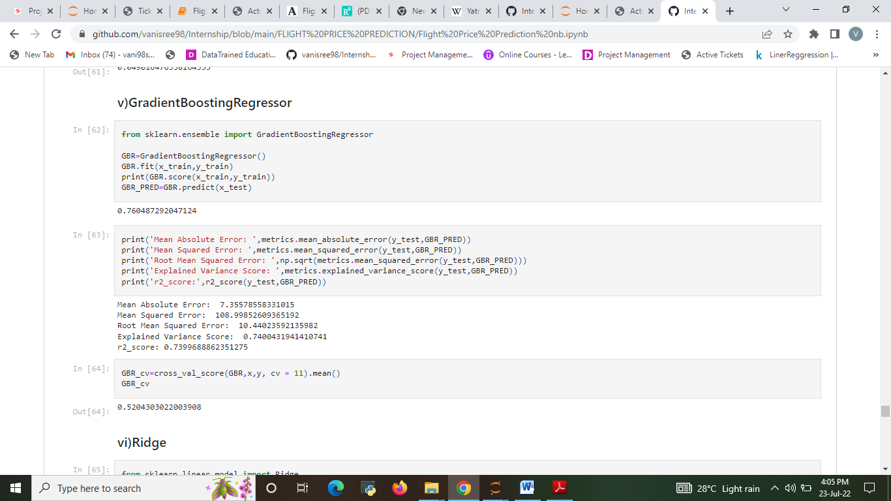
5. Gradient Boosting Regression

Slide 18
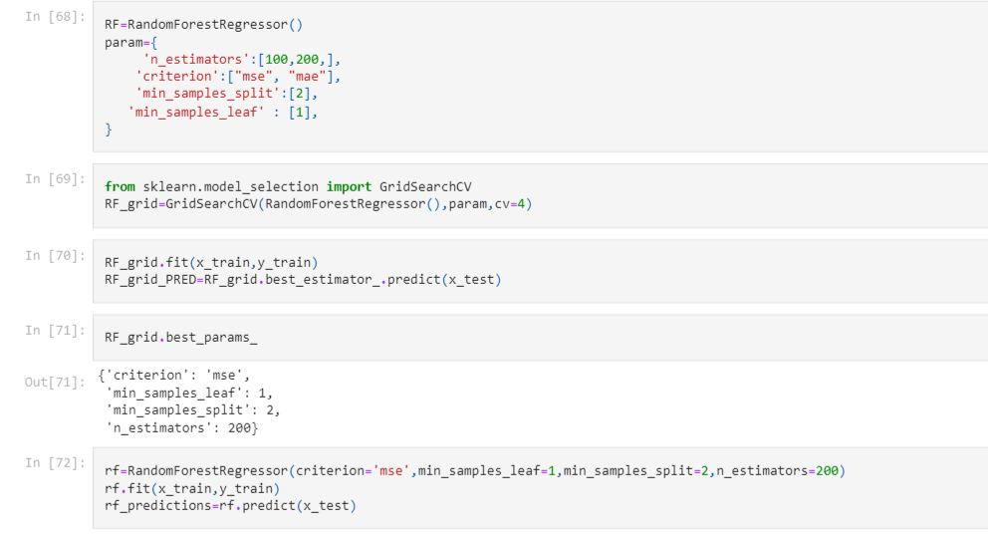
Hyper parameter tuning 1.Random Forest Regressor

Slide 19
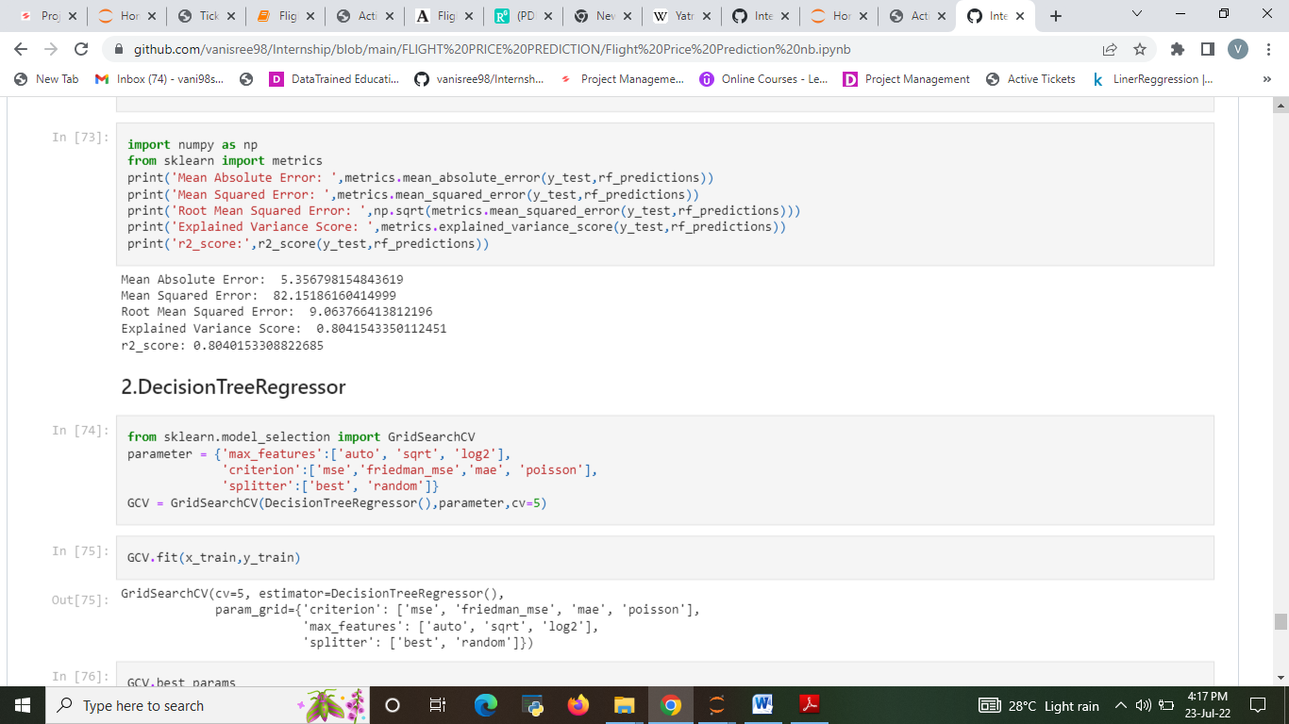

Slide 20
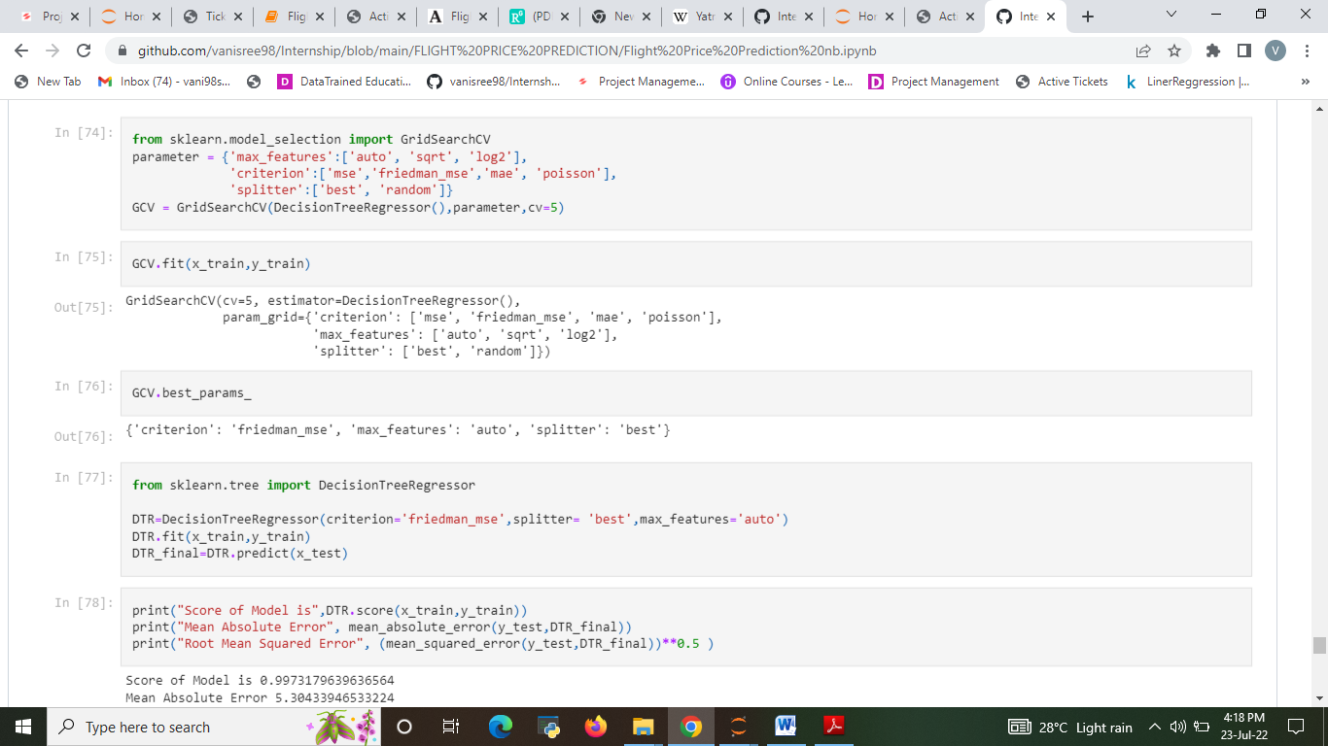
2. Decision Tree Regression

Slide 21
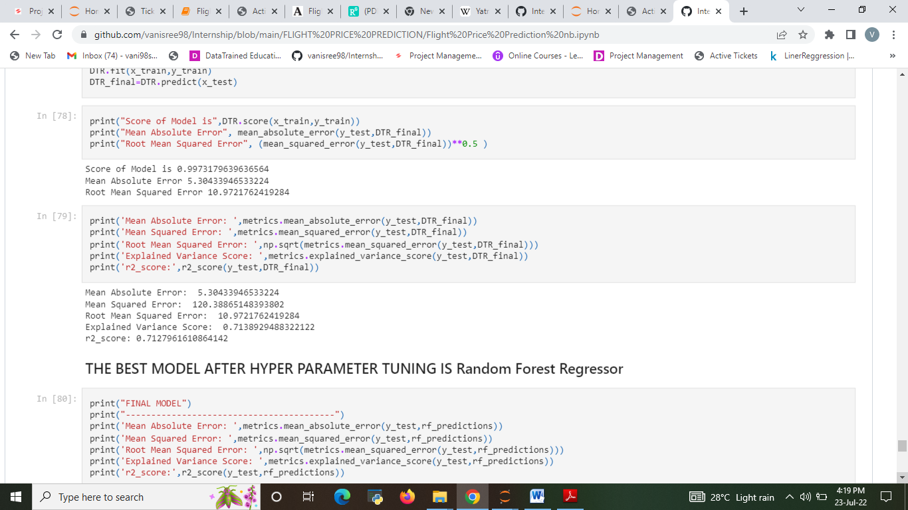

Slide 22
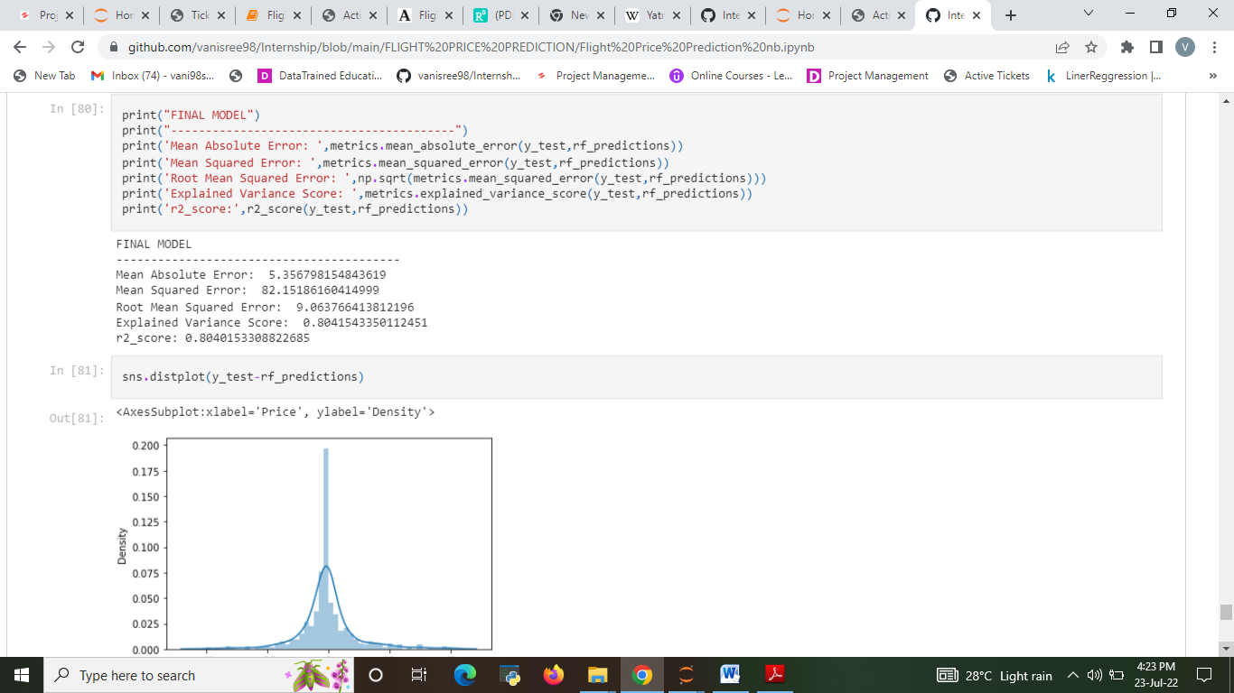
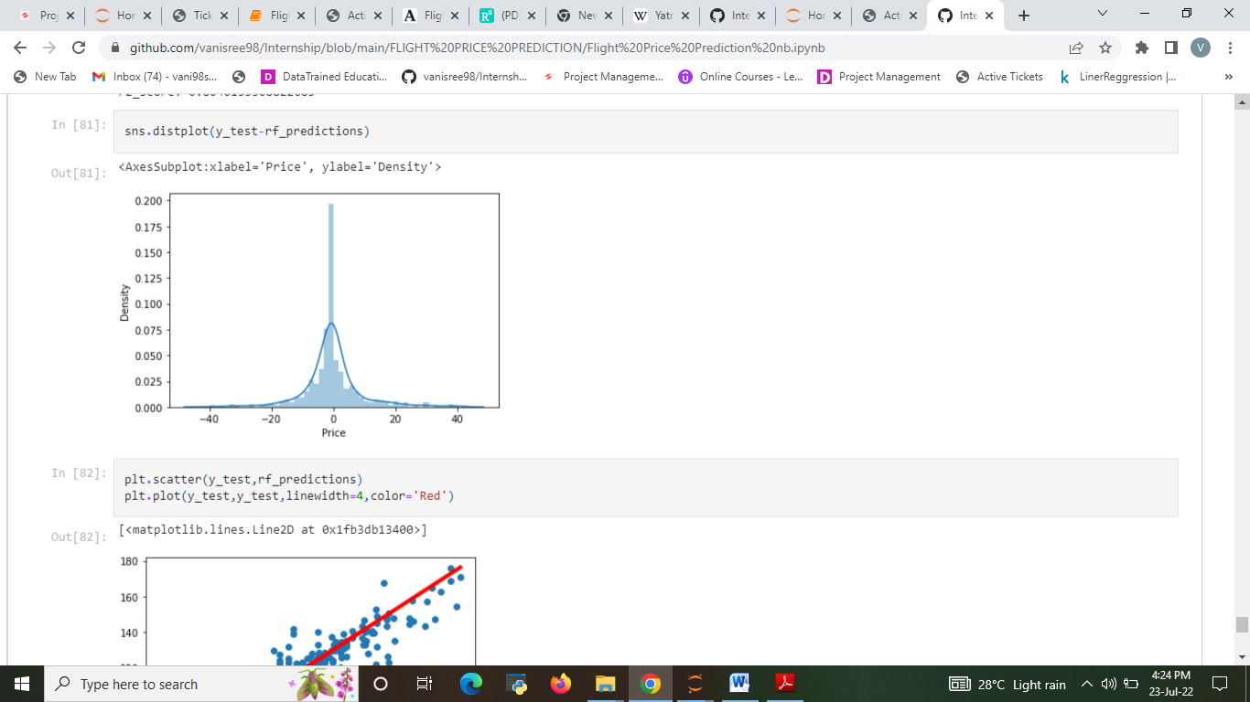
FINAL MODEL
The best model after hyper parameter tuning is Random Forest Regression

Slide 23
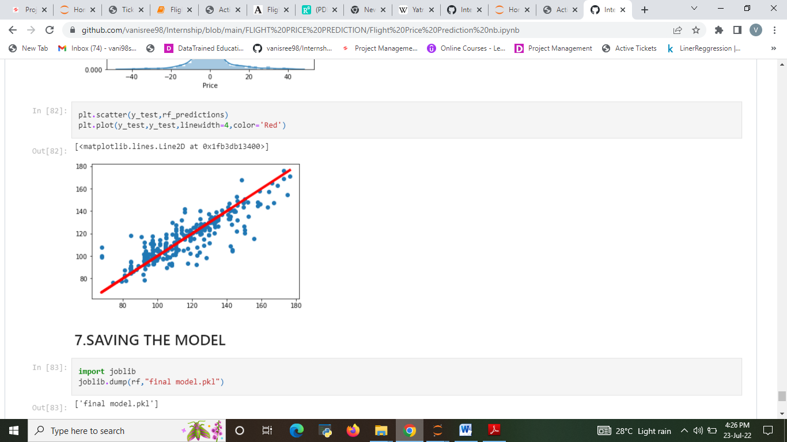

Slide 24
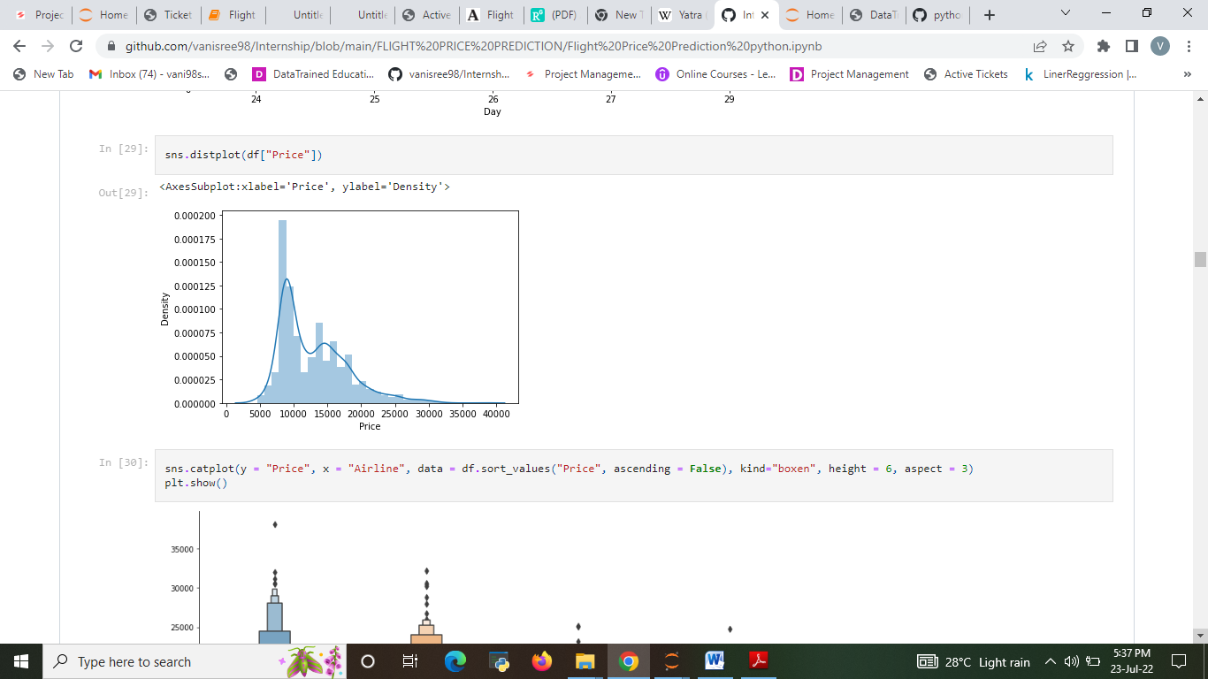
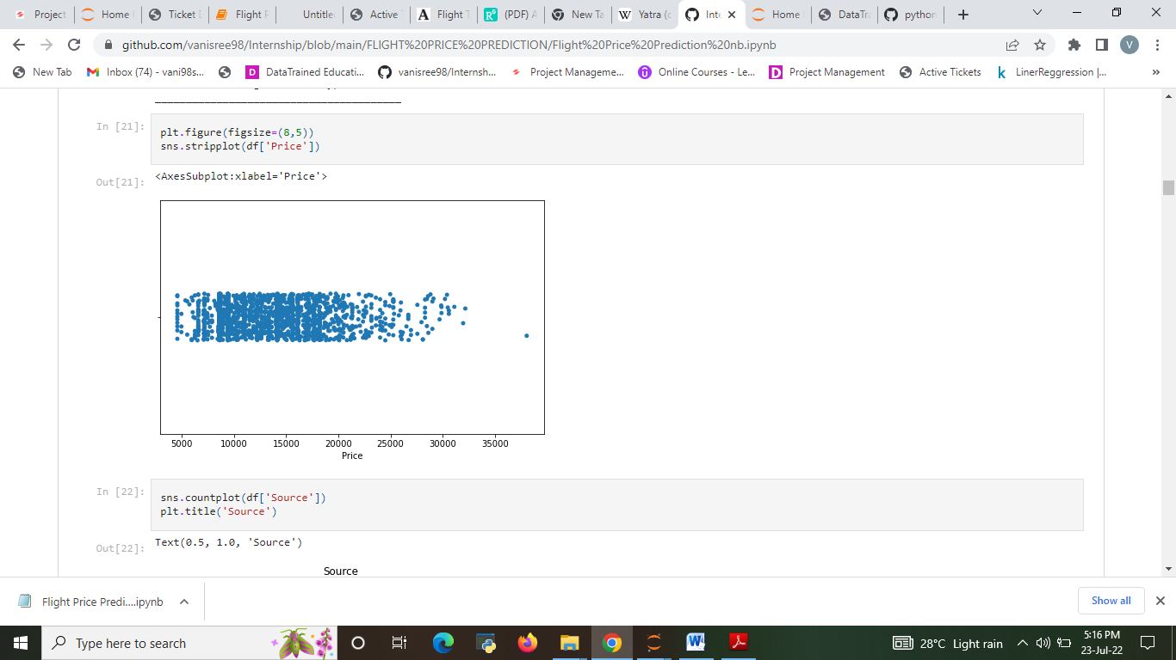
Visualizations
The Analysis of flight Price. The price of the ticket

Slide 25
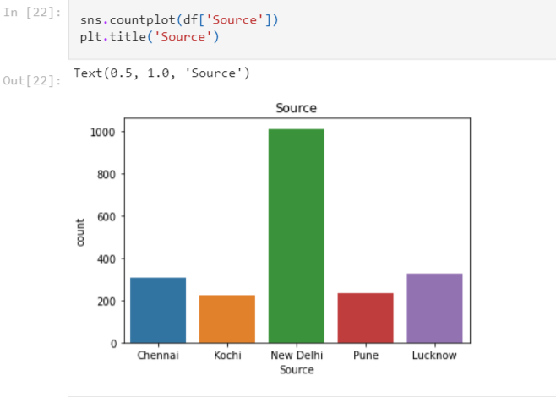
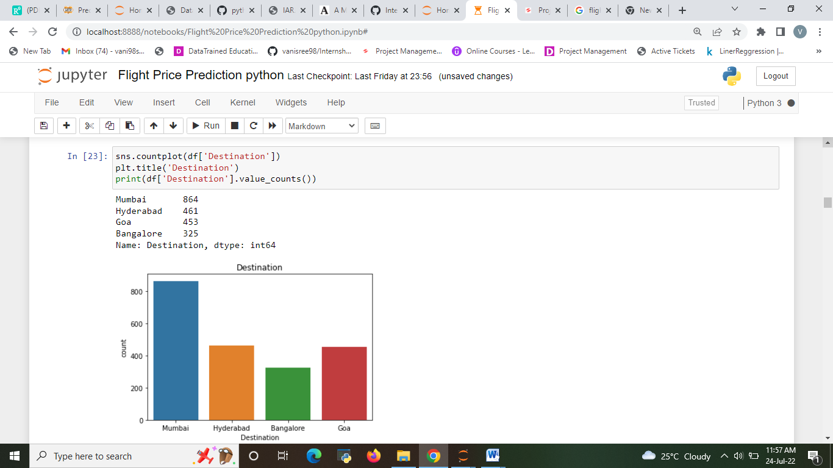
The source from which the service begins and The Analysis of The destination where the service ends.
In observation from New Delhi has more Flight service held compare with all other cities.

Slide 26
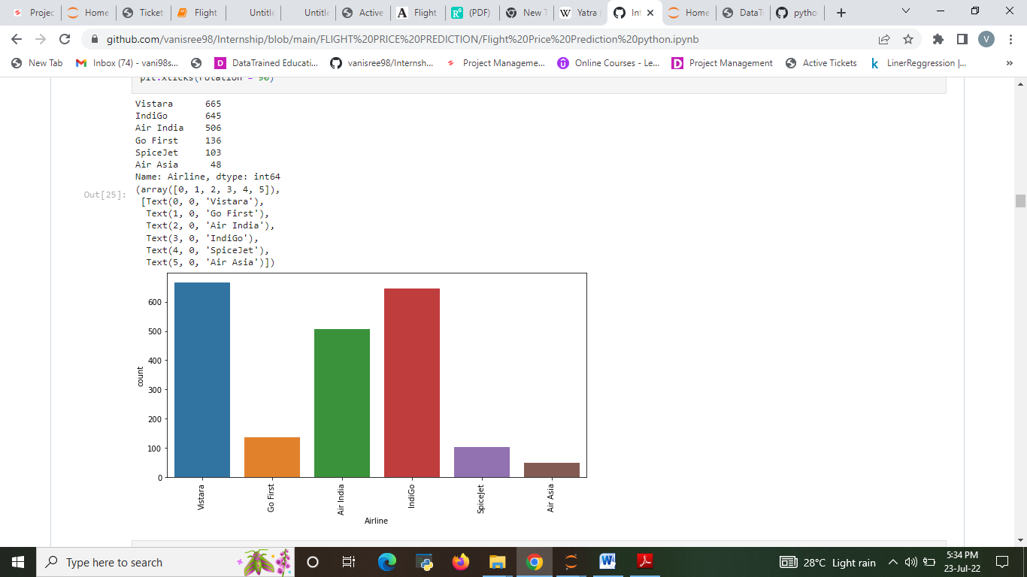
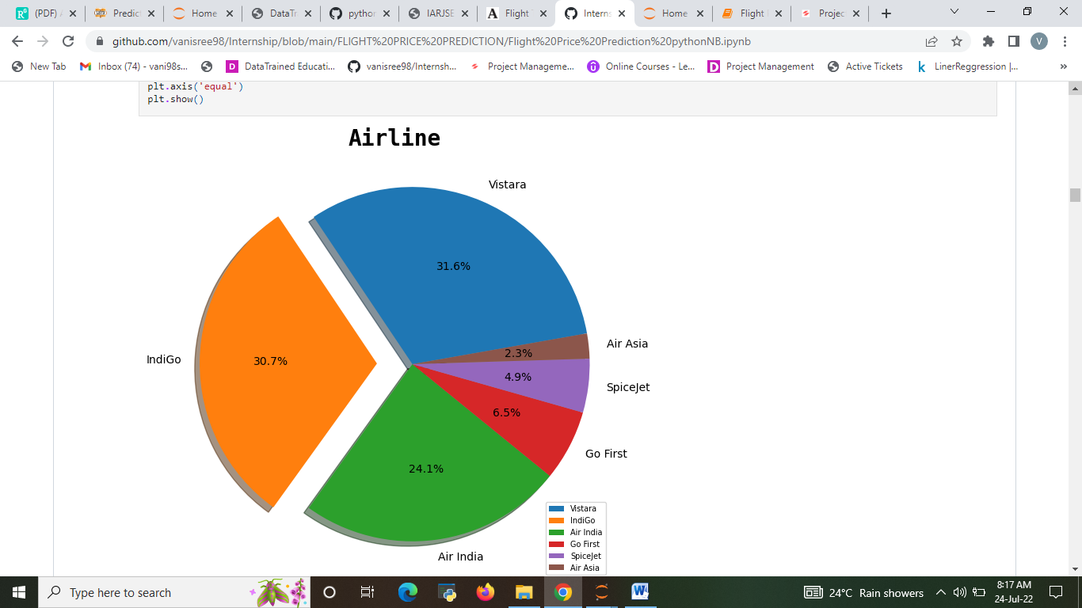
Vistara and IndiGo are the higher service provide.
Air Asia has 2.3% very low service compare with other
The Analysis of The name of the airline

Slide 27
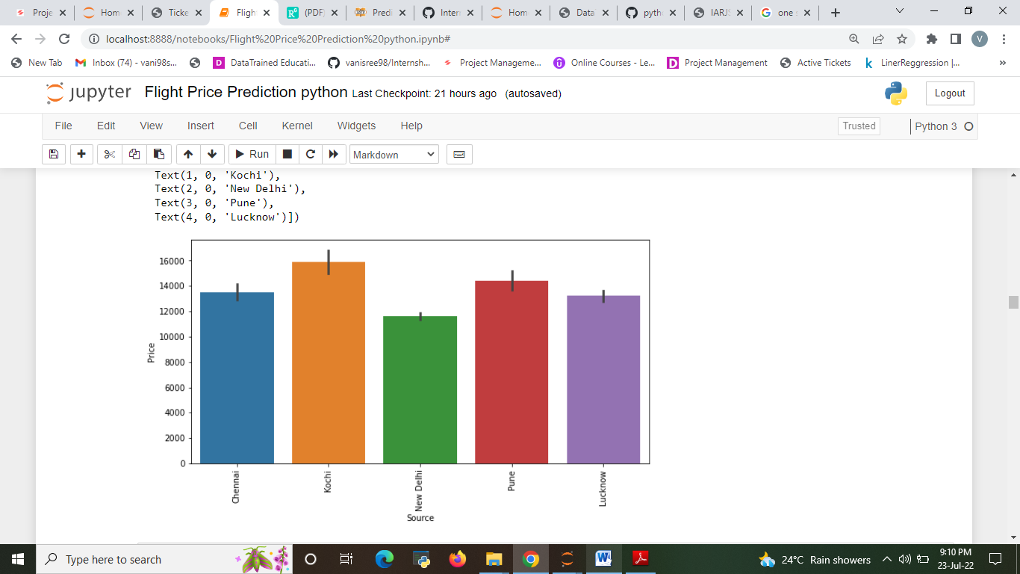
The Analysis between Source and Price

Slide 28
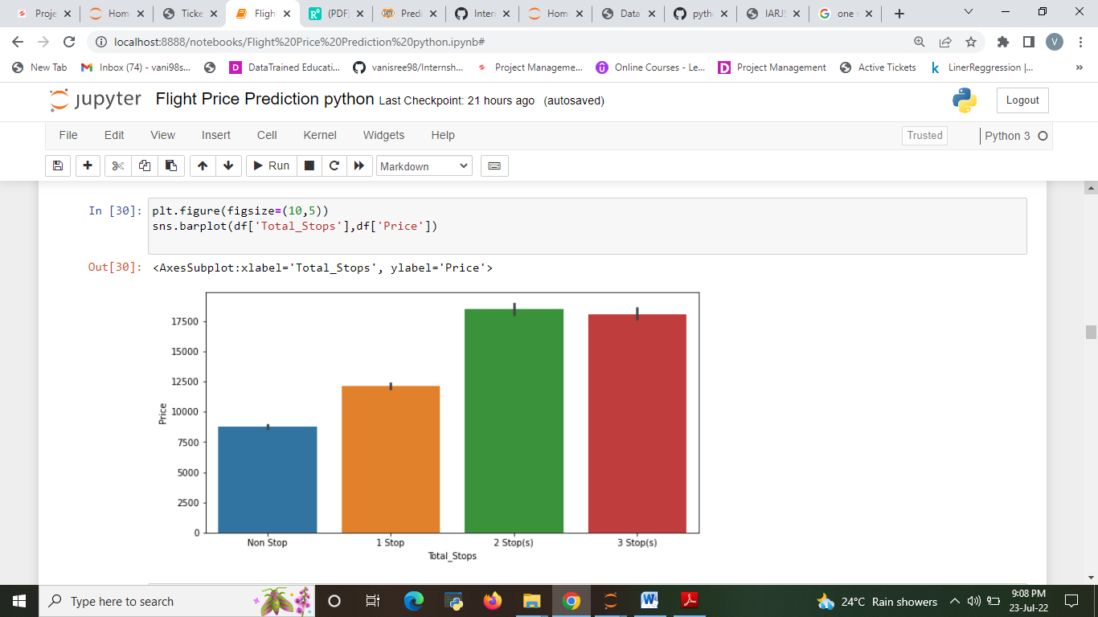
Total stops between the source and destination
2 stops and 3 stops have high flight price rate compare with others.
1 stop and Non stop have low flight price rate.

Slide 29
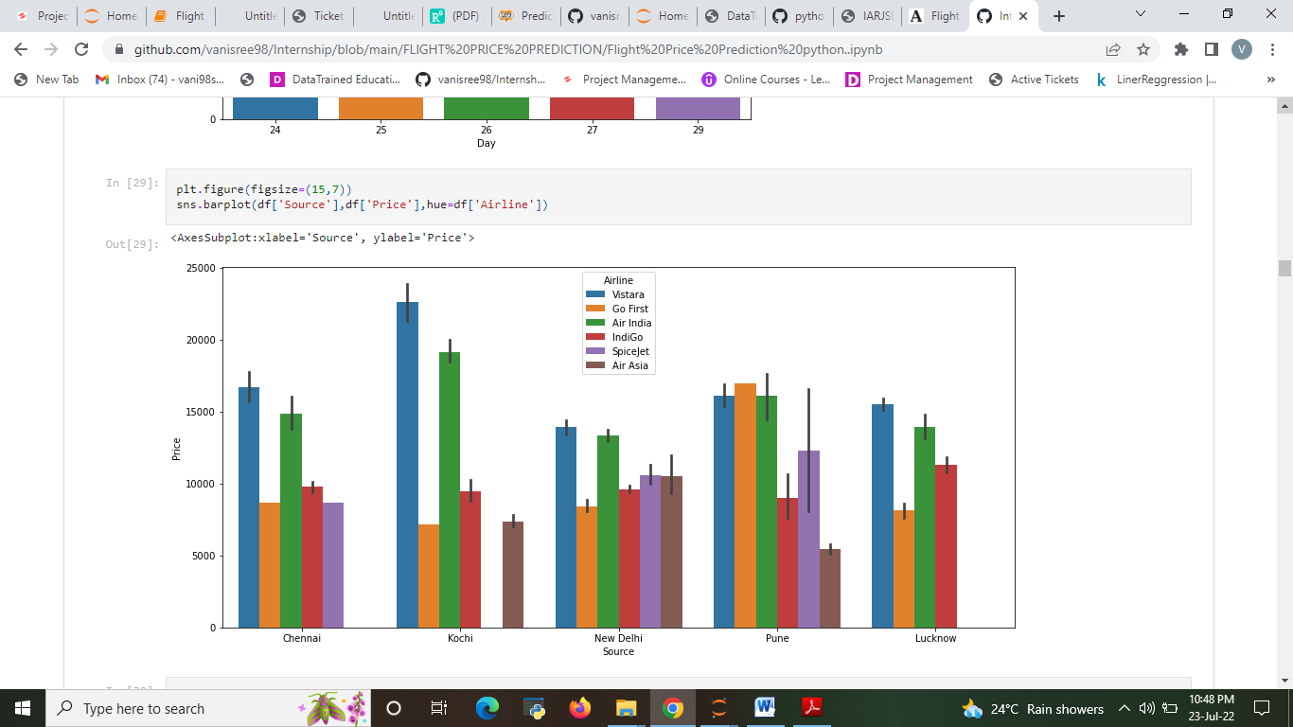
The Analysis between Source and Price

Slide 30
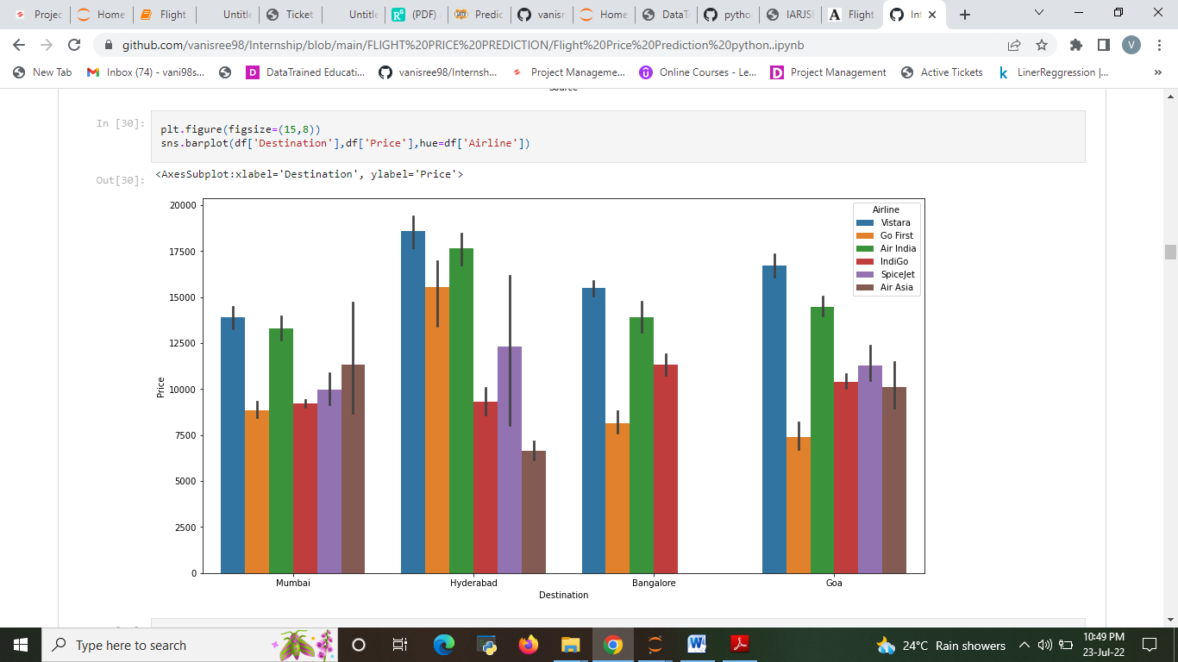
The Analysis between Destination and Price.

Slide 31
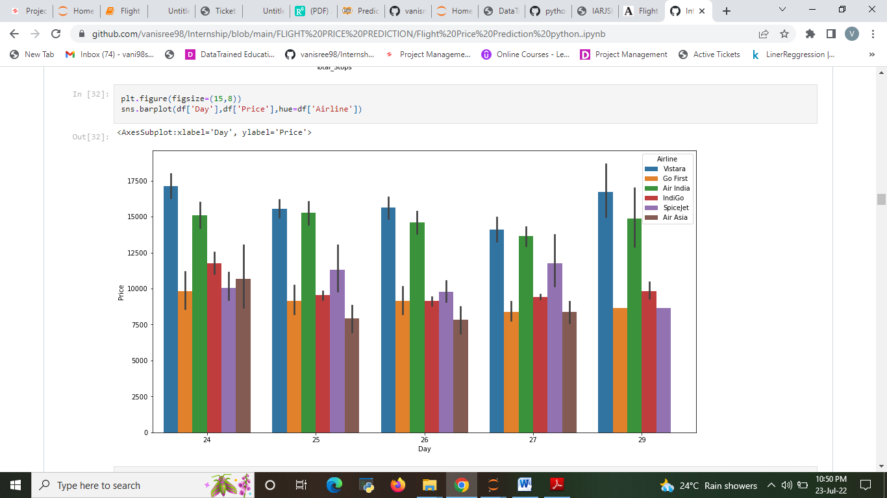
The Analysis between Day and Price

Slide 32
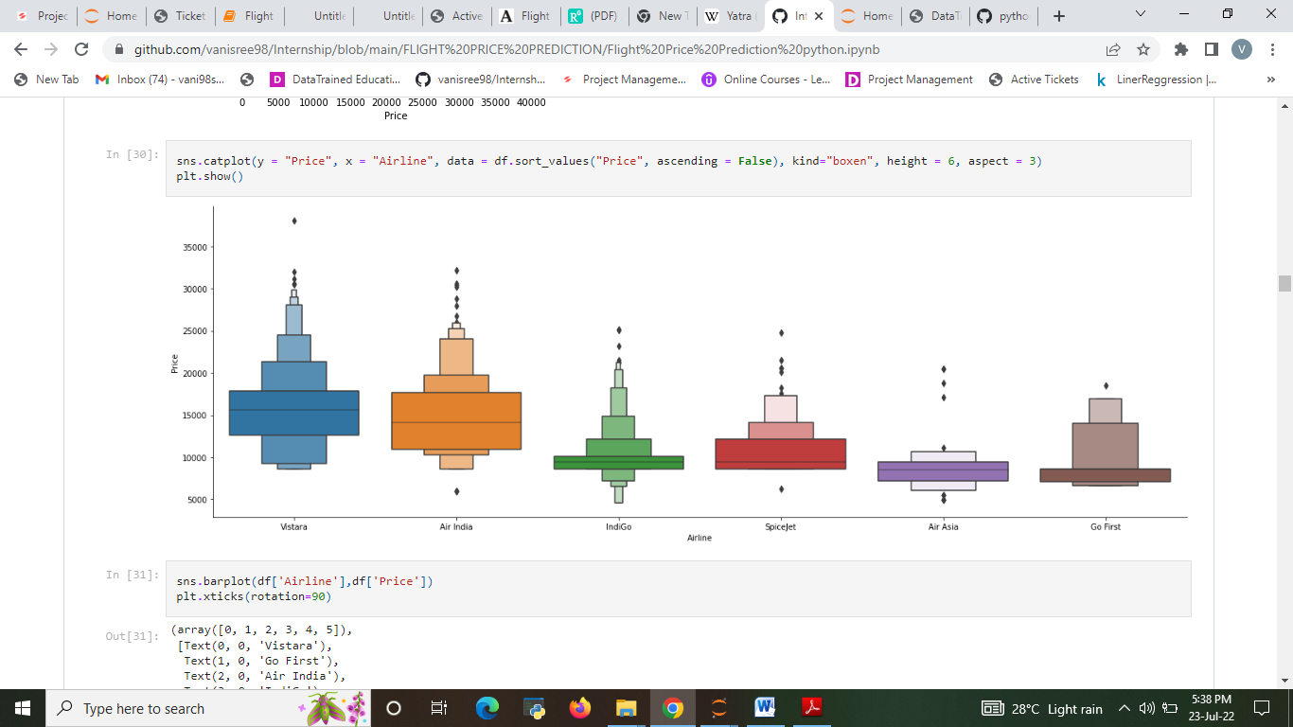
The Analysis between Airline and Price

Slide 33
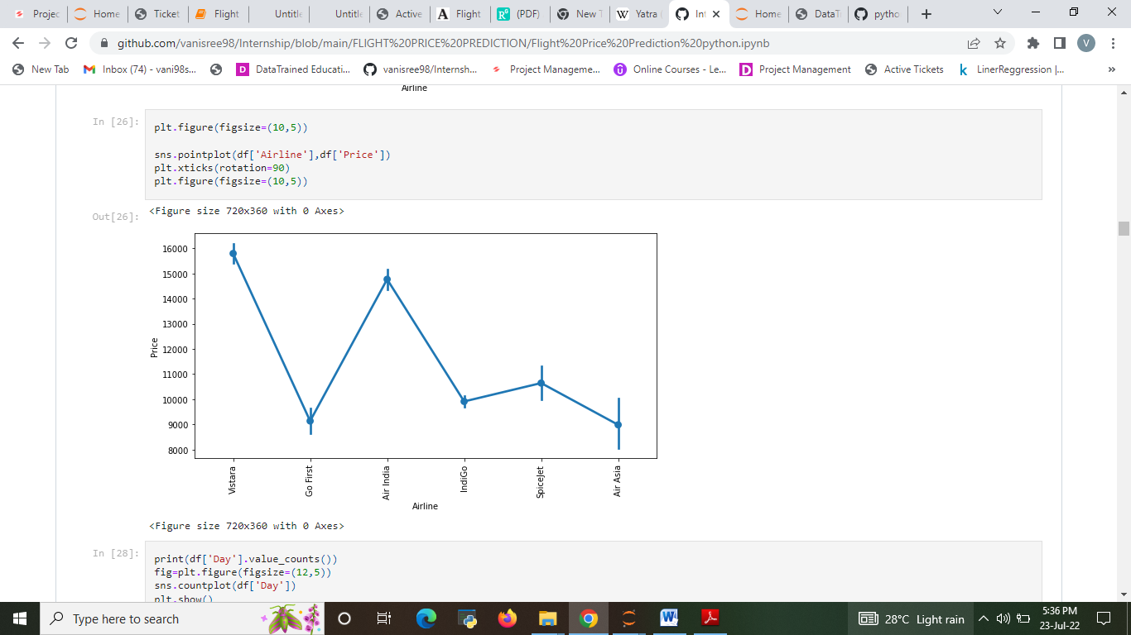

Slide 34
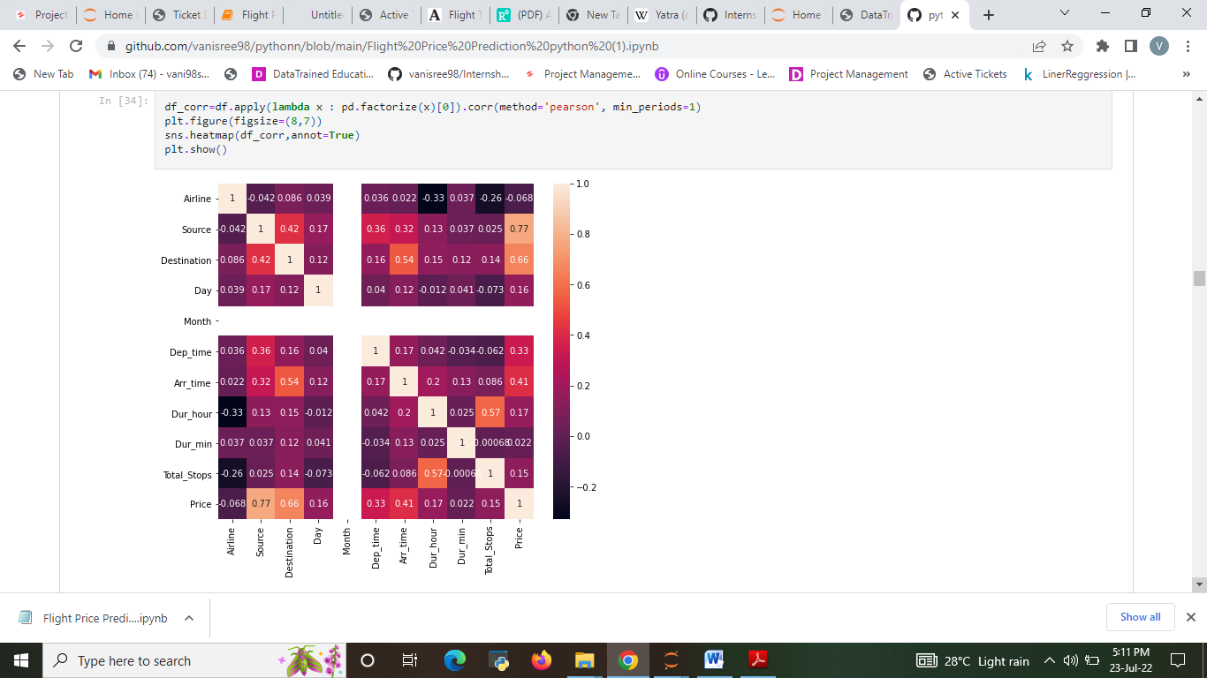
CORRELATION

Slide 35
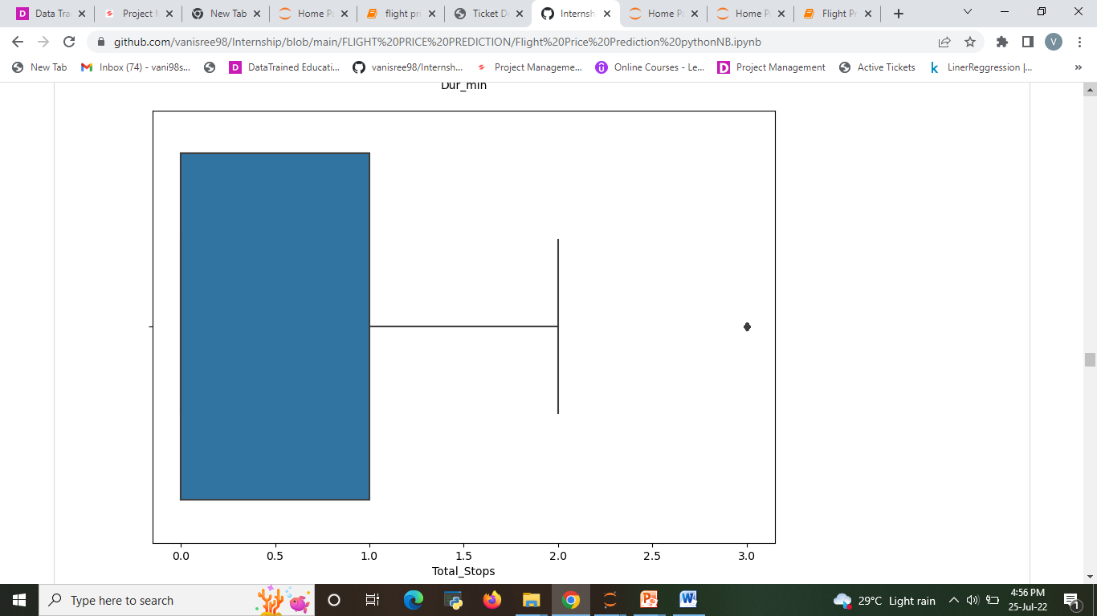
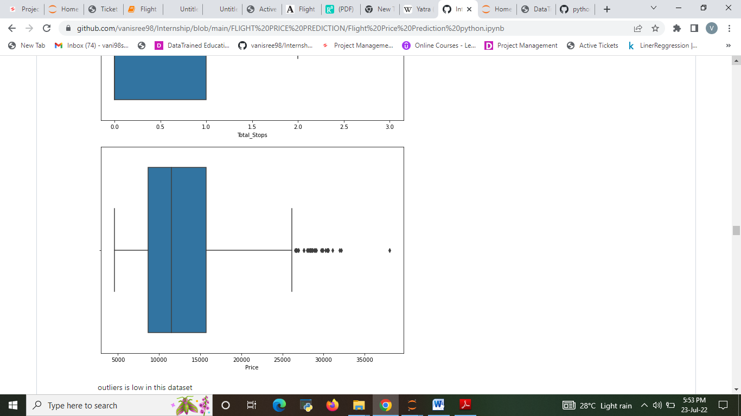
Checking the outliers

Slide 36
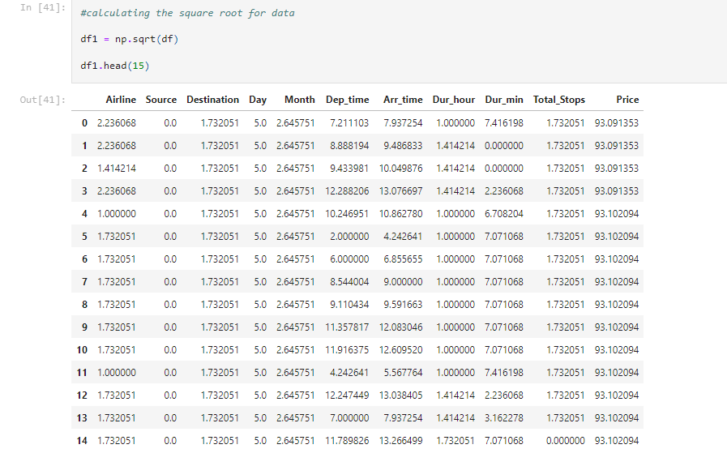
Skewness removal
Using Square root transformation methord to reduce Skewness

Slide 37
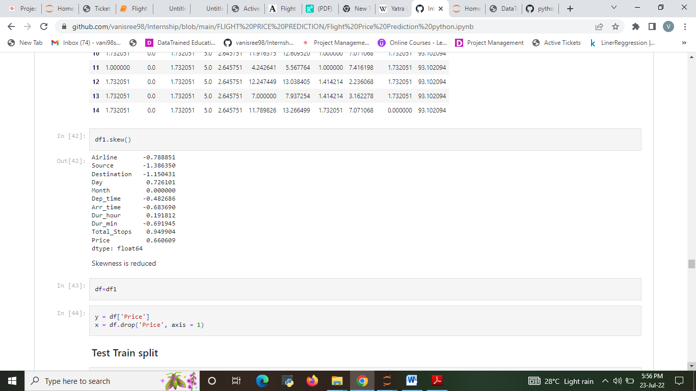
Skewness is reduced

Slide 38
Observations
Airfare varies according to the day of the week of travel. It is higher for weekends and Monday and slightly lower for the other days.
The airfare varies depending on the time of departure, making timeslot used in analysis an important parameter.
The time duration plays the important role for making the decision to board the flight with best price. With the limited amount of time the best price can be chosen by the passengers. Everybody can afford the flight ticket with best price and best offers
That travellers can see the highest to lowest prices to know the price differences in each airline. Passengers can share the review of the flight on the each airline websites, so that the other passengers gets the benefit out of it.
That duration (or distance) plays a major role in affecting air ticket prices, but we see no such pattern here, as there must be pattern here and other significant factors affecting air fare like type of airline, destination of flight, date of journey of flight (higher if collides with a public holiday).
Through this analysis the advantage is that passengers might want to reach the destination sooner, so the duration plays the important role to reach sooner with good amount of price.

Slide 39
ANALYSIS ON THE DATA
Do airfares change frequently?
Ans: Yes, Based on Season and Demand of the flight Tickets Price changes regularly.
Do they move in small increments or in large jumps? Ans. large jumps, If you buy a ticket before few of date of journey you will get arround 44% high price.
Do they tend to go up or down over time?
Ans. Price of the flight goes up only down over time but its not reduces the price over time
4. What is the best time to buy so that the consumer can save the most by taking the least risk?
Ans. Consumer should buy the ticket before 30 days of date of joureney so they can save up to 45% to 50%

Slide 40
Conclusion
I check the data first scraped and uploaded the data in jupyter notebook and than I visualize the features ,Perform the preprocessing in the data and understand the relationship between different features.
I used both train-validation split and the cross validation to evaluate the model effectiveness to predict the target values.
At the end I applied the 6 predictive models in the data.
Then after performing all the model the best model is chosen as Random forest regression.
This system also helps the buyer to buy the flight ticket at lower price. It is easy to use and it gives more accuracy in prediction. It requires less time for prediction and it helps in reduction of over fitting.
Travellers can save money if they choose to buy the ticket when its price is the lowest. It gives the customer the best time to buy a flight ticket for the desired destination and a period

Slide 41
Limitations and Scope
For the prediction of the ticket prices perfectly different prediction models are tested for the better prediction accuracy.
As the pricing models of the company are developed in order to maximize the revenue management .With the help of our project the travellers can find out the right time to buy their tickets at the lowest cost and also can plan accordingly.
So to get result with maximum accuracy regression analysis is used. From the studies, the feature that influences the price ticket are to be considered. In future the details about number of available seats can improve the performance of the model
We might have often heard travellers saying that flight ticket prices are so unpredictable. As data scientists, we are going to prove that given the right data anything can be predicted.
So the collected train data should be accurate if not it may result in wrong prediction. And also it is necessary to update the train data time to time for best results

